Slide 1
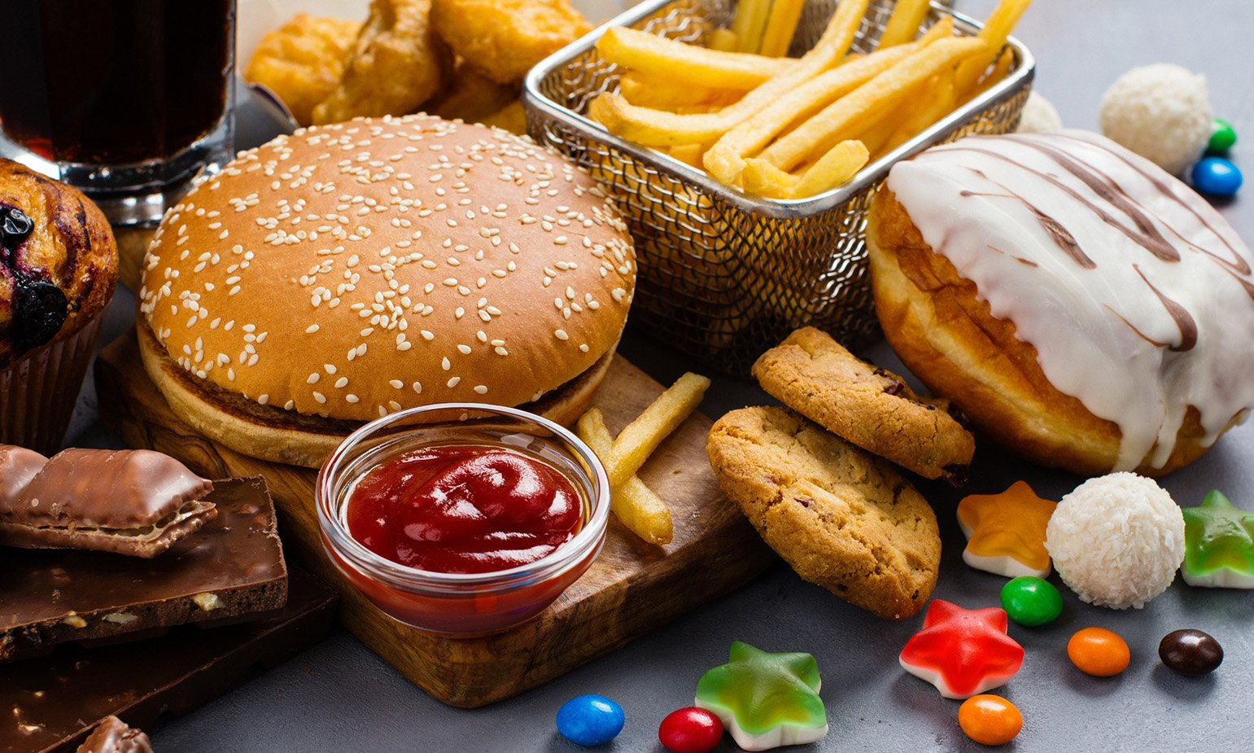
An Interdisciplinary Project Review: Nutrition + Statistics
Zoe Zhang, Tony Gong, Jasmine Leung, Aoni Fu, Haoru Yang, Ethan Li

Slide 2
Can ultra-processed food consumption increase obesity risk in low-socioeconomic (SES) groups in Australia?

Slide 3
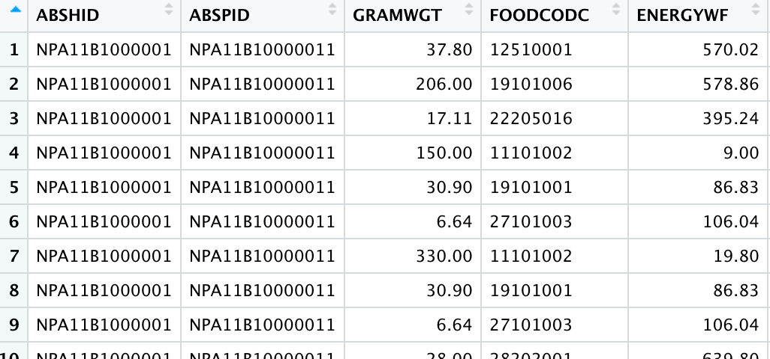
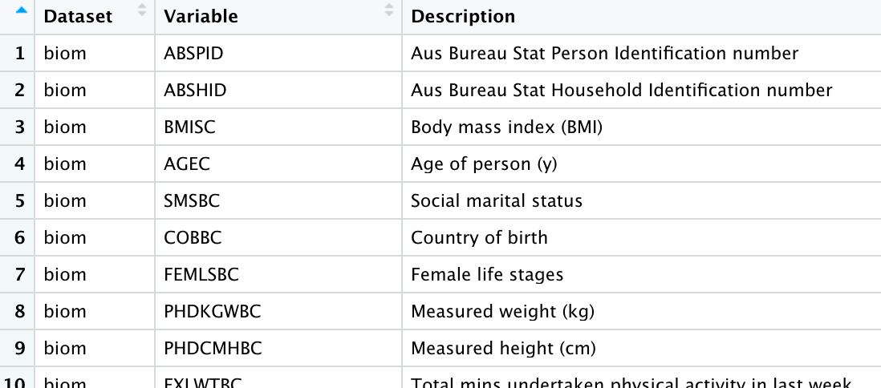
Datasets
Dataset names | Rows (Observations) | Columns (Variables)
 | 825 | 7
tech_biom | 12,153 | 54
 | 341,897 | 226
tech_nutr | 12153 | 191
dictionary
tech_food

Slide 4
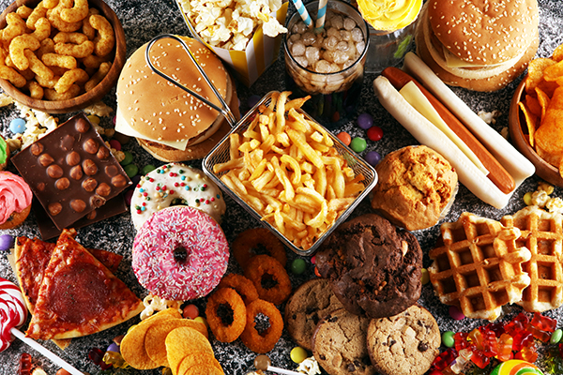
Hypothesis
Ultra-processed food consumption increases obesity risk in low-SES groups in Australia

Slide 5
Aims
01
Whether low-SES groups consume more UPF compared to other SES groups
Ultra-Processed Foods
02
Whether increased UPF ratio increases energy intake (i.e., protein leverage hypothesis)
Obesity
Socioeconomic Status
03
Whether UPF consumption significantly contributes to obesity in low-SES groups

Slide 6
Methods
NUTM
Food variables categorized into 5 levels based on NOVA Classification (Monteiro et al., 2019)
Unprocessed
Minimally processed
Processed culinary
Processed foods
Ultra-processed
STATS
Data wrangling
Model construction
Classification tree
Random forest
Logistic regression
K - Nearest neighbour

Slide 7
Results

Slide 8
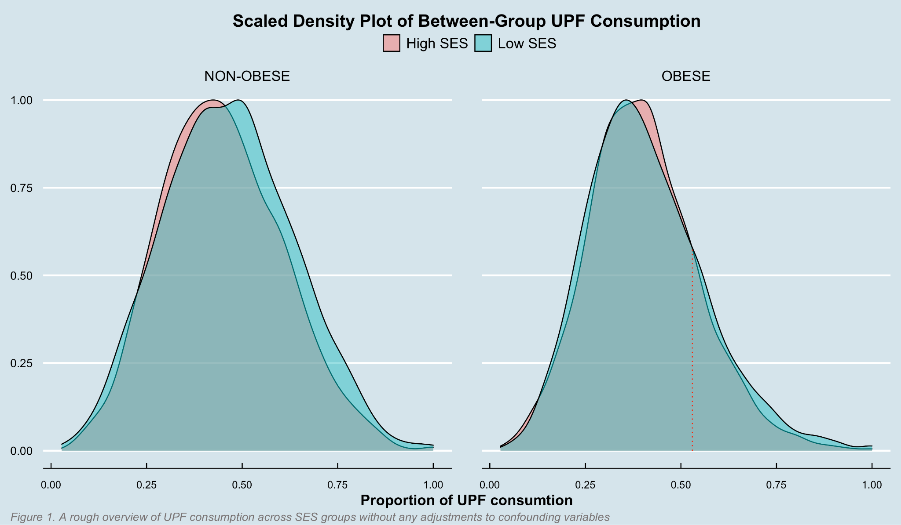
Aim 1: Whether low-SES groups consume more UPF compared to other SES groups
In the range of high-level UPF consumption, people from low-SES¹ groups do consume more UPF than those from high-SES groups regardless of obesity.
1. People in the first and second decile of an index which measures relative Socio-Economic Disadvantage

Slide 9
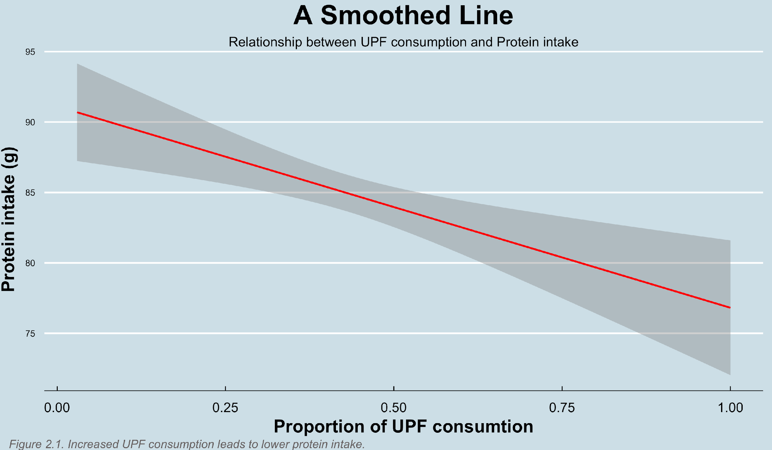
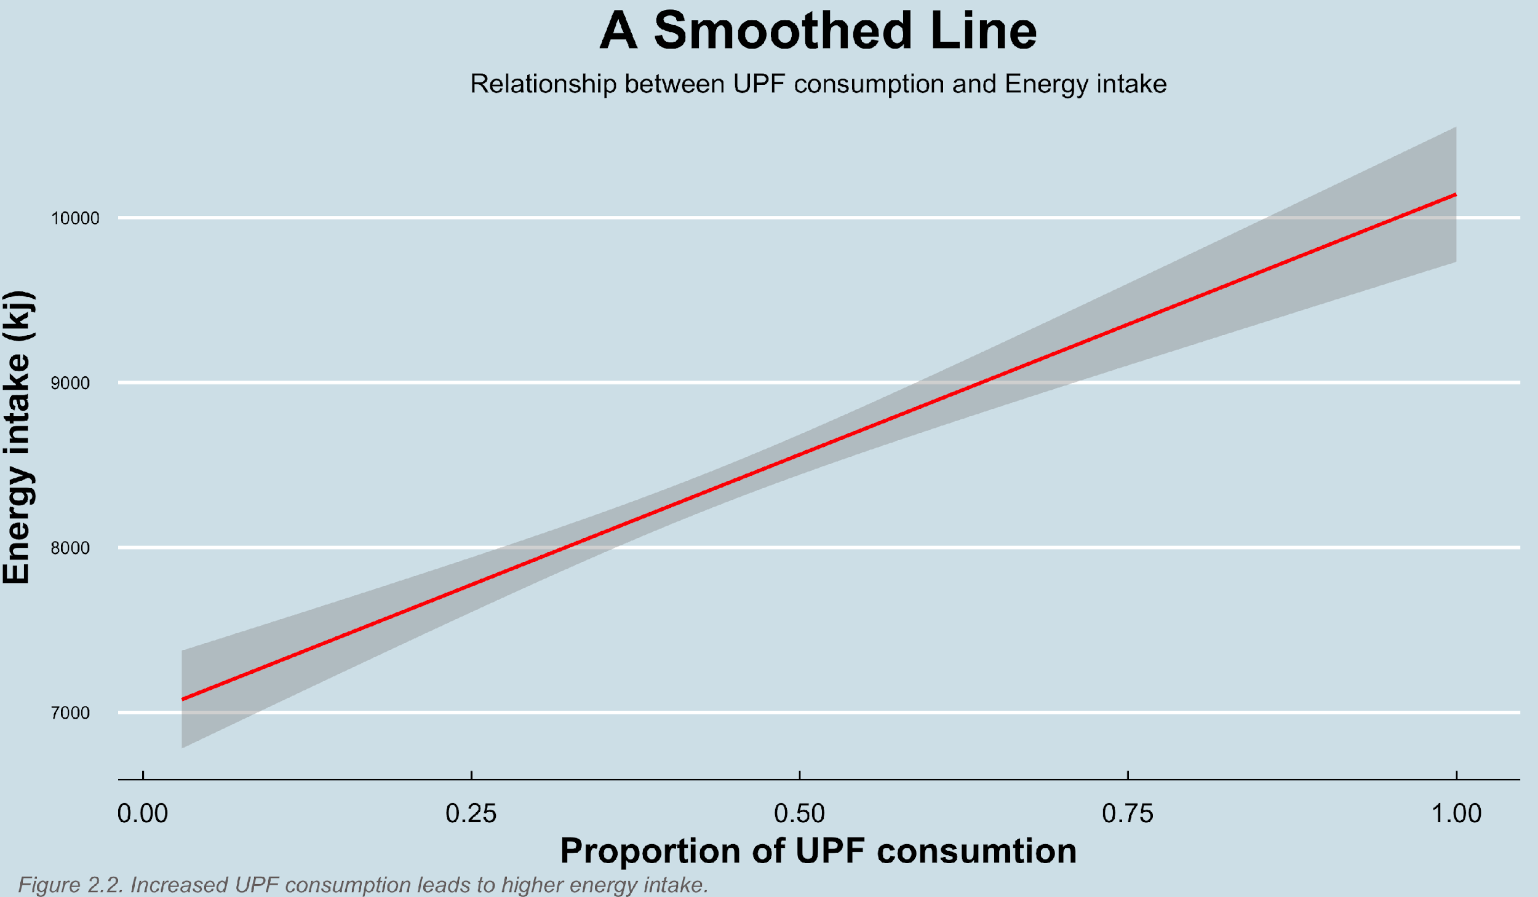
Aim 2：Whether increased UPF ratio leads to lower protein and increased energy intake ratio among the low-SES group
Increasing UPF consumption in diet tends to dilute dietary protein intake.
However, according to the protein leverage hypothesis, macronutrient regulation of relatively constant protein results in increasing energy intake and obesity risk (Martinez et al.,2018).

Slide 10
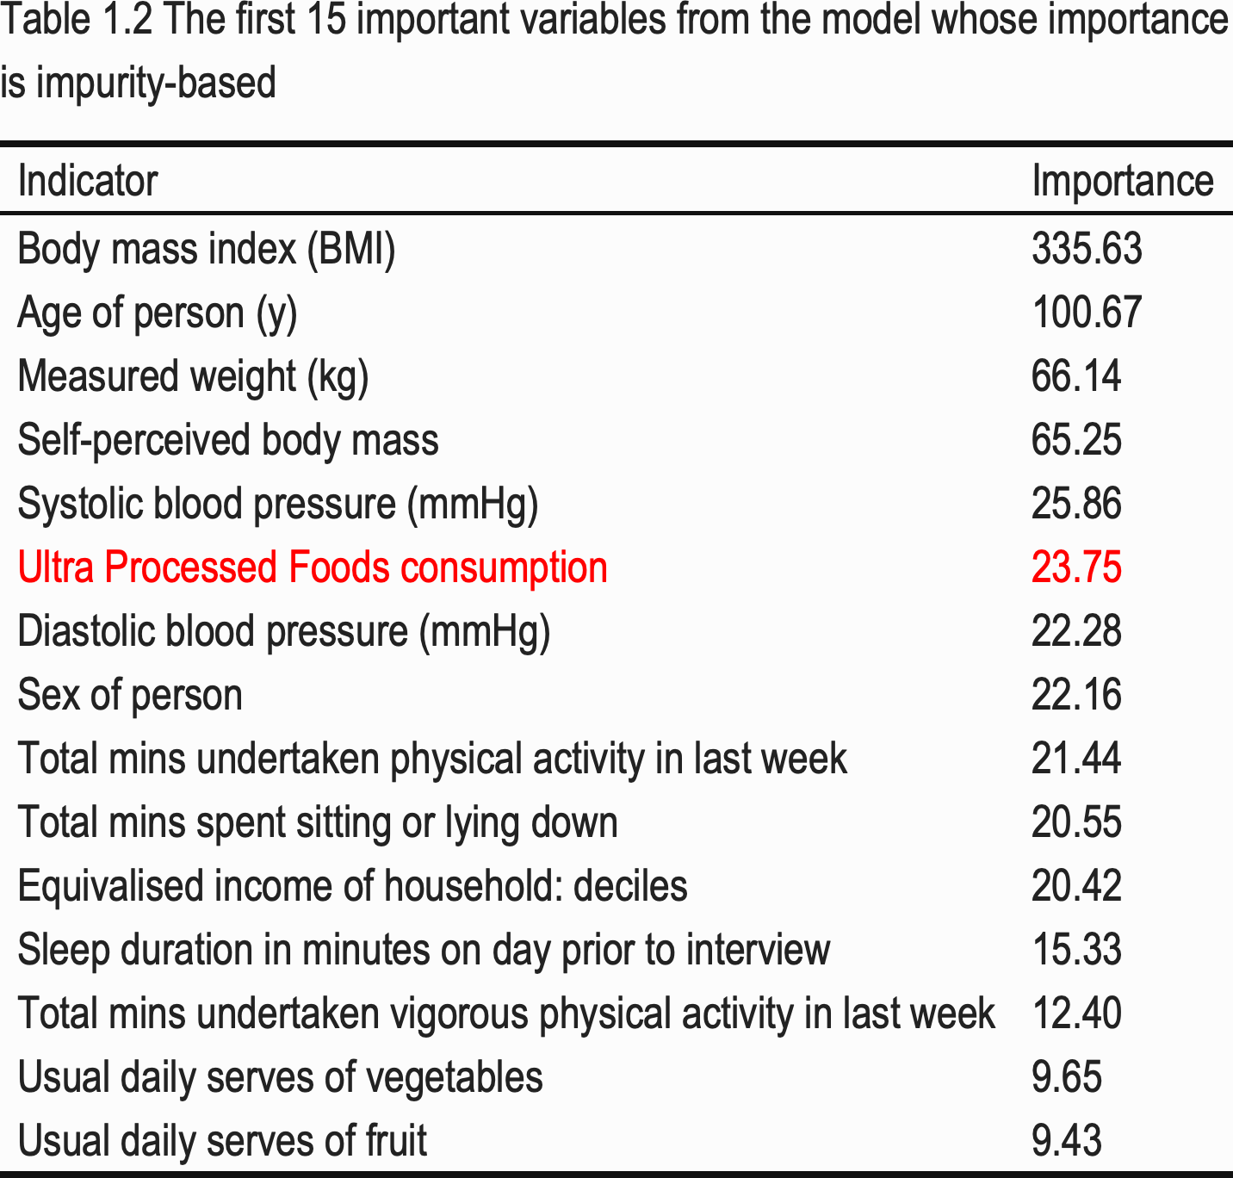
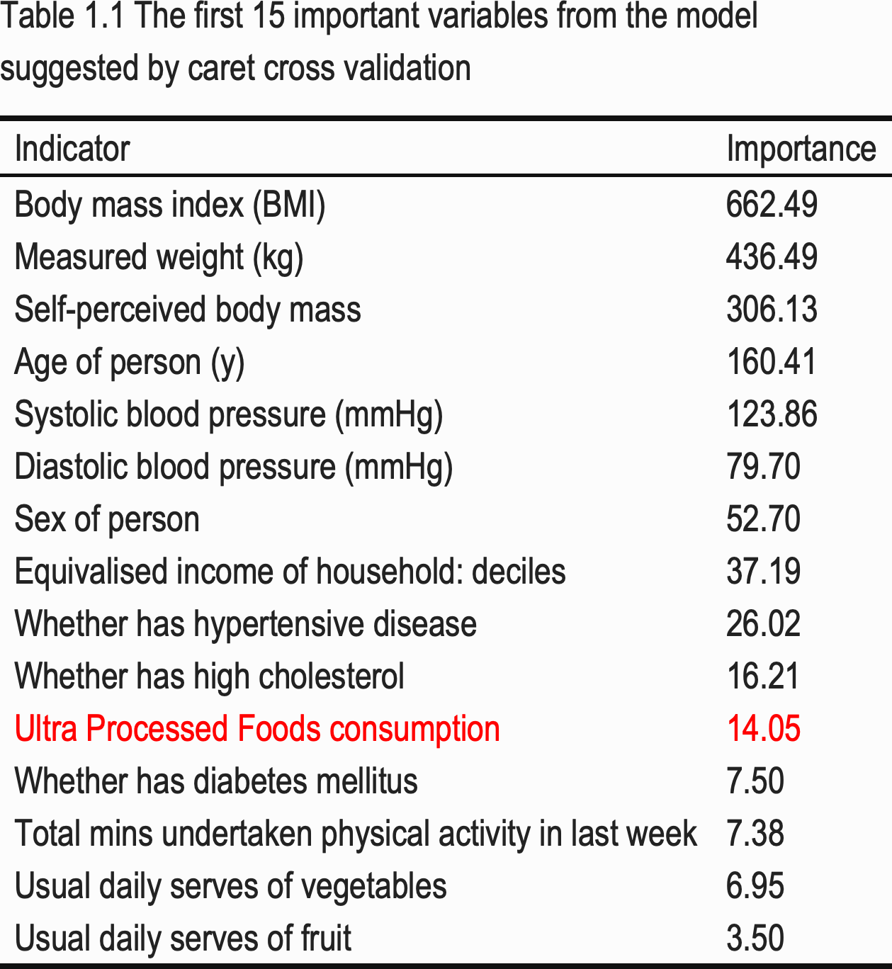

Aim 3: Whether UPF consumption is a significant contributor to obesity in low-SES groups
Random Forest
Classification Tree
Logistic Regression
K-means Clustering
Penalty introduced
Significant?

Slide 11
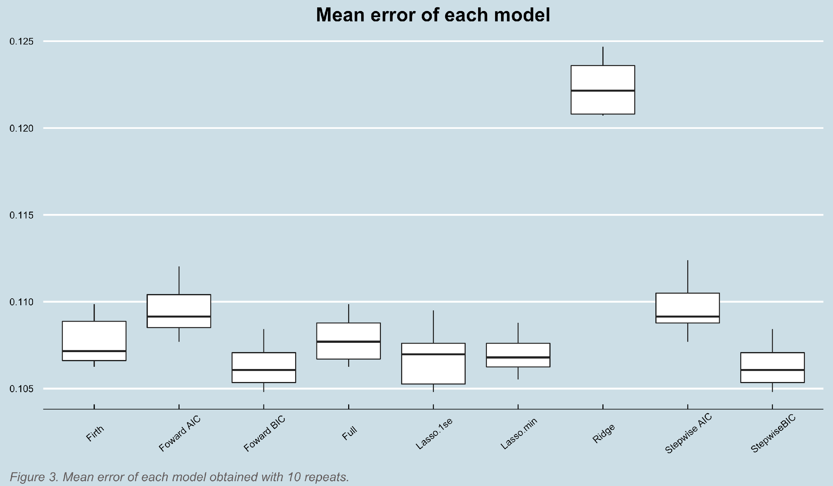
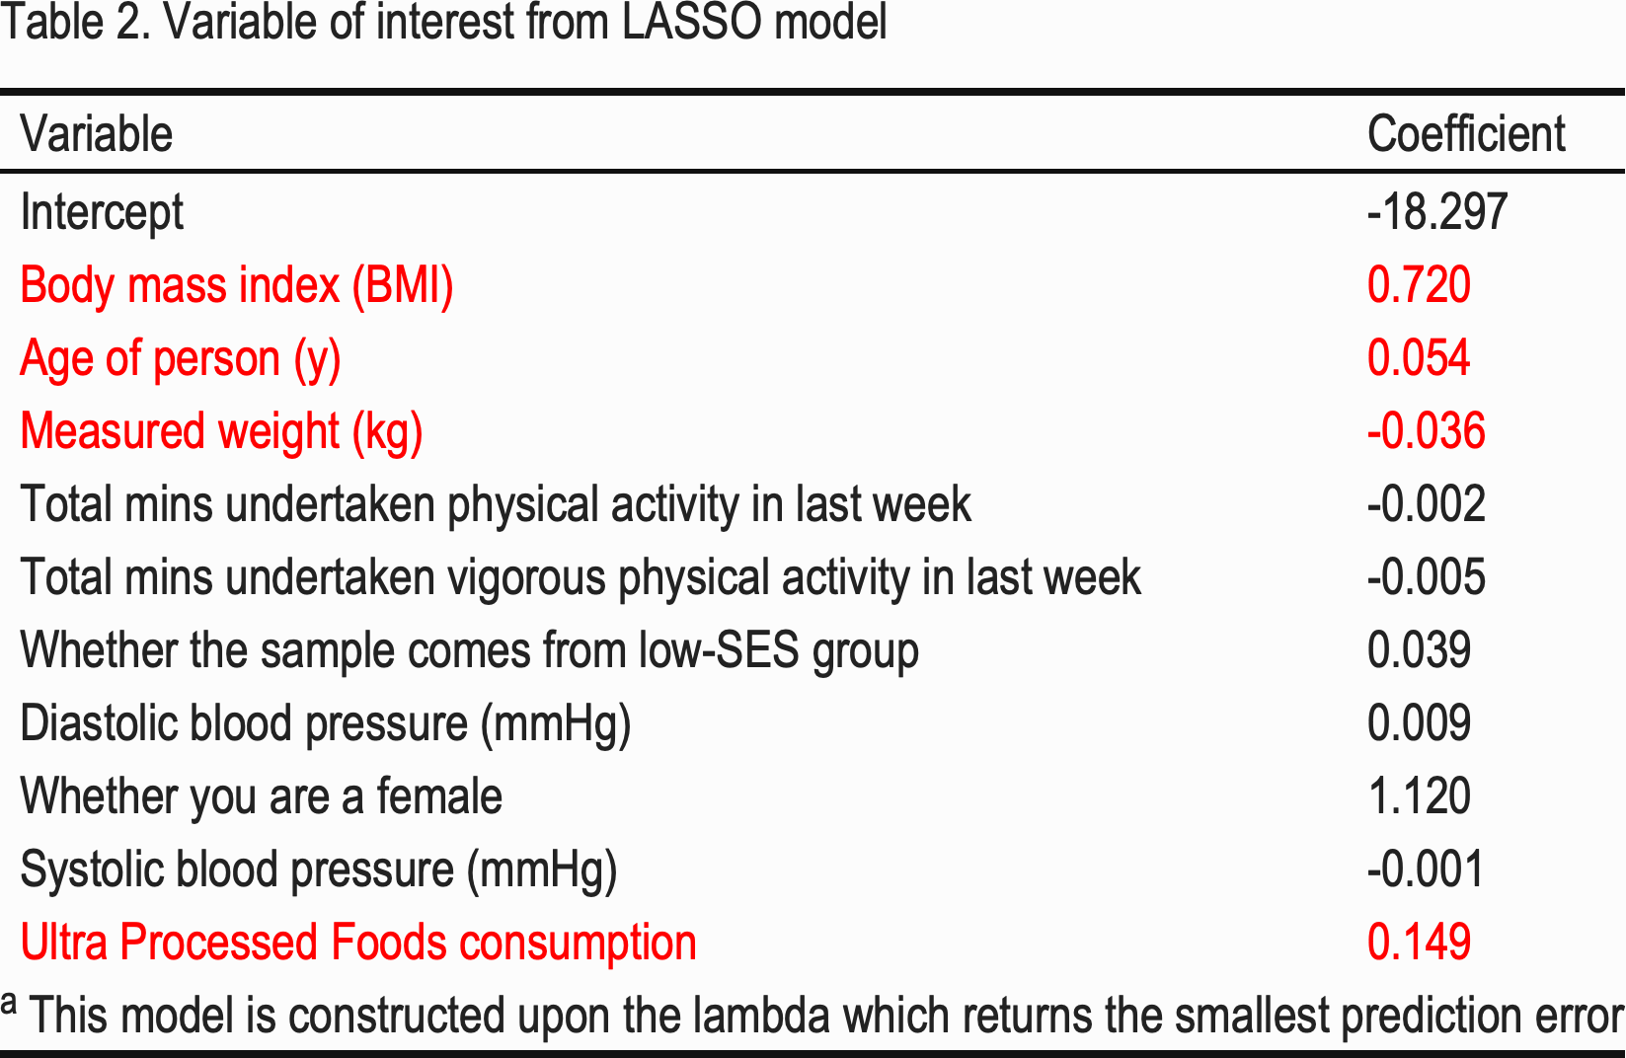
Aim 3: Whether UPF consumption is a significant contributor to obesity in low-SES groups

Slide 12
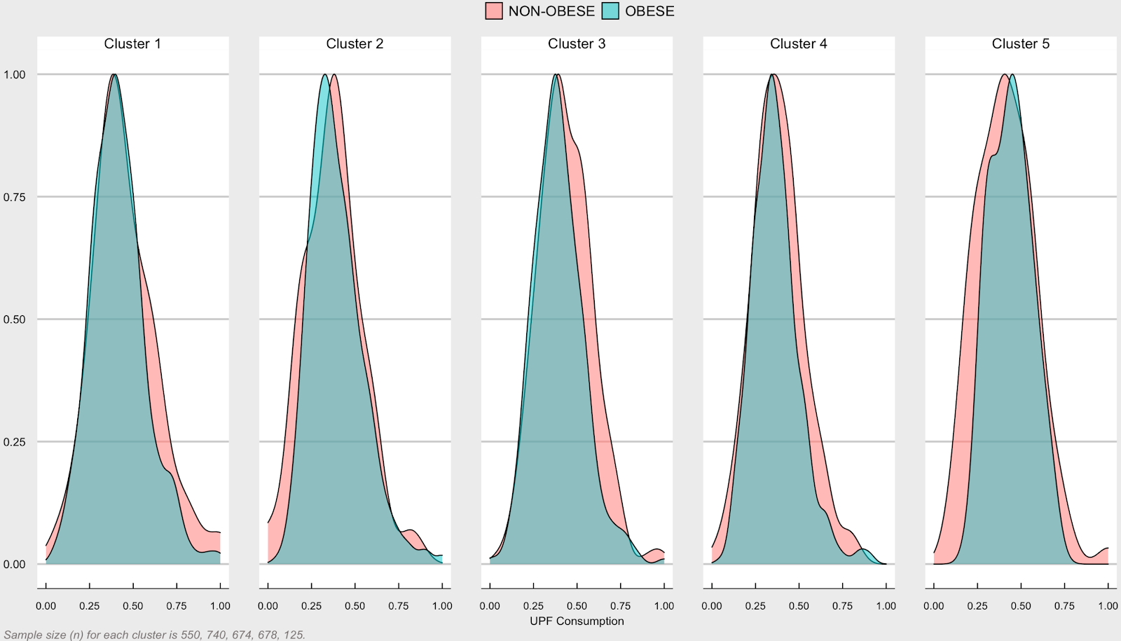
Aim 3: Whether UPF consumption is a significant contributor to obesity in low-SES groups
Figure 4. Density plot between UPF consumption and the number of obese people in low SES group

Slide 13
Conclusions
Contrary to the hypothesis, this study found small, non-significant effects of UPF consumption on obesity prevalence in low-SES groups in Australia.
Limitations
Manual categorization of food variables into NOVA criteria may be error-prone
Not all confounding variables excluded.
Doubtful robustness of established model
E.g. computationally expensive to increase repeat times during Cross Validation. Thus, we only use 10 instead.
The ‘elbow’ in results from K means clustering is not clear.
Within-group similarity (cluster) needs to be further checked.

Slide 14
References
Martínez Steele, E., Raubenheimer, D., Simpson, S. J., Baraldi, L. G., & Monteiro, C. A. (2018). Ultra-processed foods, protein leverage and energy intake in the USA. Public Health Nutrition, 21(1), 114–124. https://doi.org/10.1017/S1368980017001574
Monteiro, C. A., Cannon, G., Lawrence, M., Laura Da Costa Louzada, M., & Machado, P. P. (2019). Ultra-processed foods, diet quality, and health using the NOVA classification system. http://www.wipo.int/amc/en/mediation/rules

